Slide 1
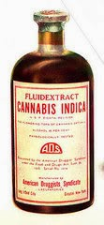
CANNABIS INDICA Dr.P.R.SAIJI ASSOCIATE PROFESSOR DEPT OF MATERIA MEDICA

Slide 2
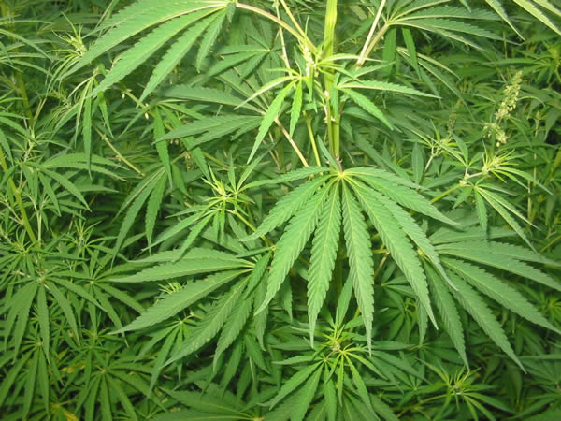

Slide 3
Common Name : Indian Hemp Natural Order: Urticaceae Habitat: Persia And Northern India Preparation: Mother Tincture Prepared From Dry Tops Imported From India.

Slide 4
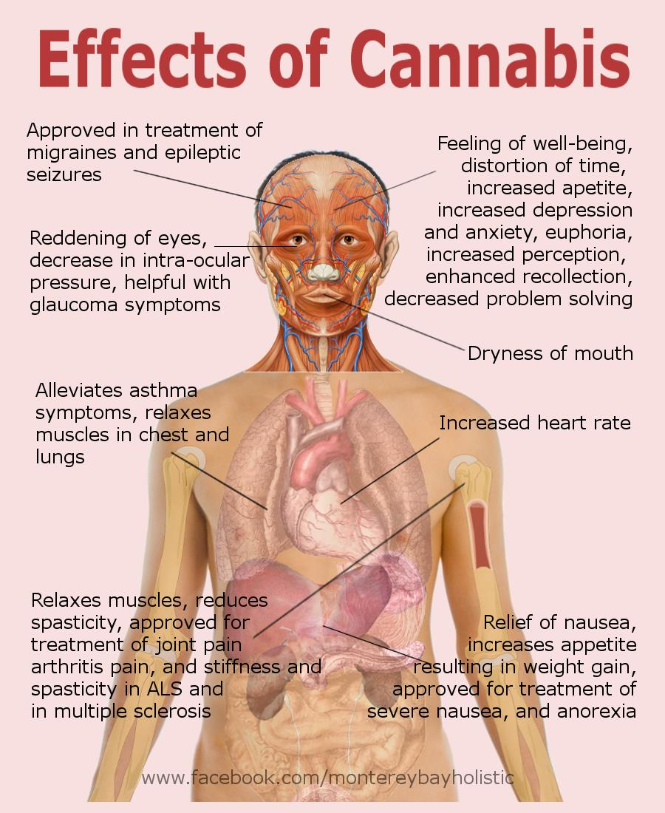

Slide 5
Inhibits the higher faculties and stimulates the imagination to a remarkable degree without any marked stimulation of the lower or animal instinct. A condition of intense exaltation, in which all perceptions and conceptions, all sensations and all emotions are exaggerated to the utmost degree.

Slide 6
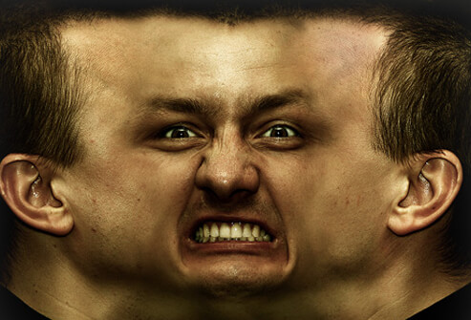
Subconscious or dual nature state. Apparently under the control of the second self, but, the original self, prevents the performance of acts which are under the domination of the second self. Apparently the two natures cannot act independently, one acting as a check, upon the other

Slide 7
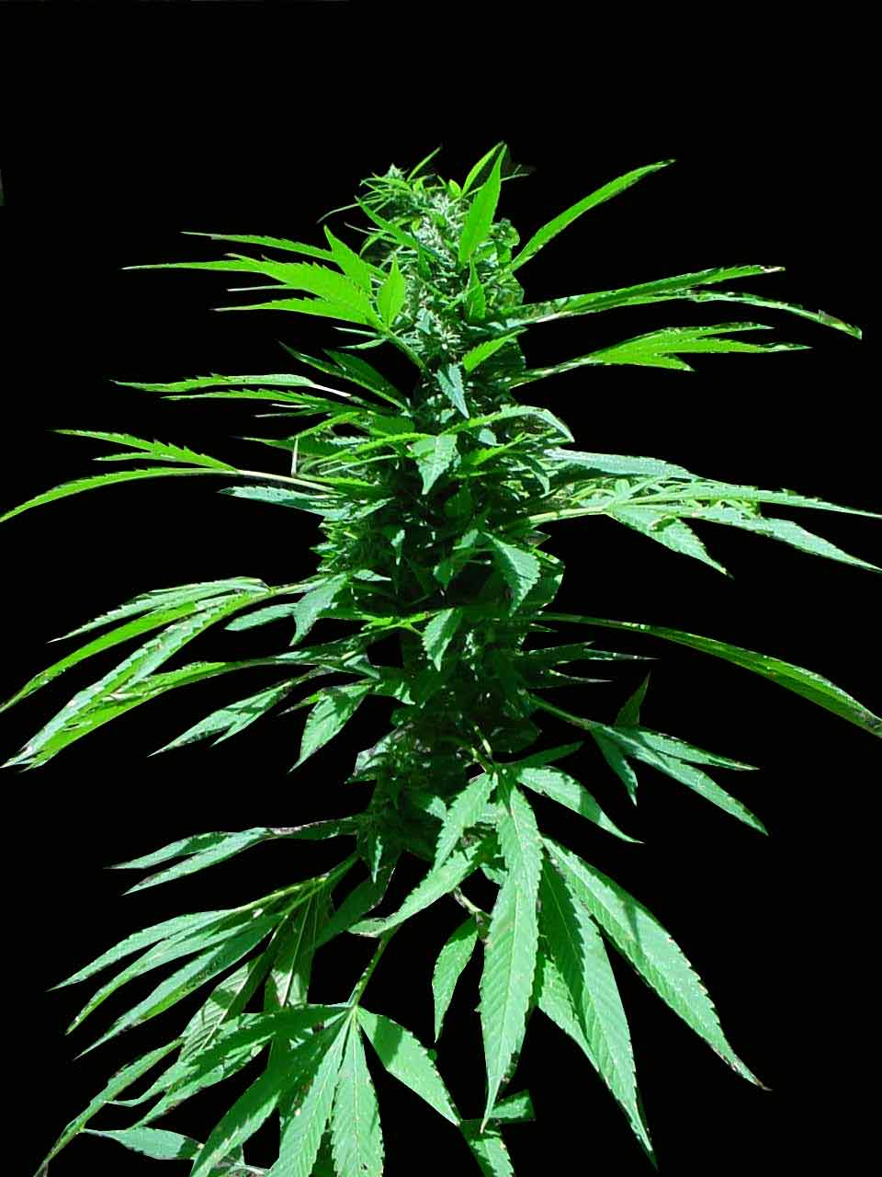
The experimenter feels ever and anon that he is distinct from the subject of the hashish dream and can think rationally.

Slide 8
Produces the most remarkable hallucinations and imaginations, exaggeration of the duration of time and extent of space, being most characteristic. Conception of time, space and place is gone. Extremely happy and contented, nothing troubles. Ideas crowd upon each other. Has great soothing influence in many nervous disorders, like epilepsy, mania, dementia, delirium tremens, and irritable reflexes. Exophthalmic goitre. Catalepsy.

Slide 9
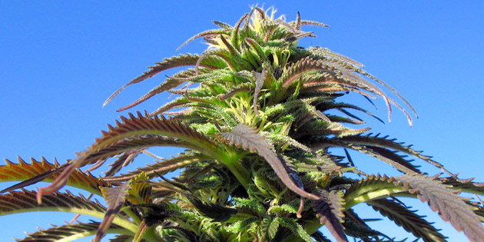

Slide 10
MIND. Excessive loquacity; exuberance of spirits. Time seems too long; seconds seem ages; a few rods an immense distance. Constantly theorizing. Anxious depression; constant fear of becoming insane. Mania, must constantly move. Very forgetful; cannot finish sentence.

Slide 11
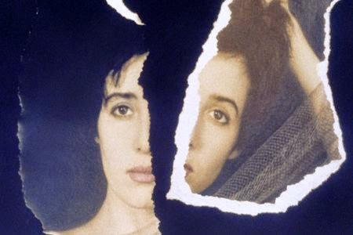
Is lost in delicious thought. Uncontrollable laughter. Delirium tremens. Clairvoyance. Emotional excitement; rapid change of mood. Cannot realize her identity, chronic vertigo as of floating off.

Slide 12
HEAD. Feels as if top of head were opening and shutting and as if calvarium were being lifted. Shocks through brain (Aloe; Coca). Uremic headache. Throbbing and weight at occiput. Headache with flatulence. Involuntary shaking of head. Migraine attack preceded by unusual excitement with loquacity.

Slide 13
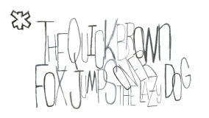
EYES. Fixed. Letters run together when reading. Clairvoyance. Spectral illusions without terror. EARS. Throbbing, buzzing, and ringing. Noise like boiling water. Extreme sensitiveness to noise.

Slide 14
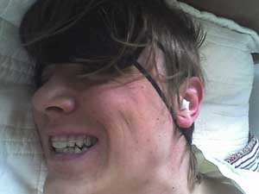
FACE. Expression drowsy and stupid. Lips glued together. Grinding of teeth in sleep. Mouth and lips dry. Saliva thick, frothy, and sticky.

Slide 15
STOMACH. Increased appetite. Pain at cardiac orifice; better, pressure. Distension. Pyloric spasm. Sensation of extreme tension in abdominal vessels-feel distended to bursting. RECTUM. Sensation in anus as if sitting on a ball.

Slide 16
URINARY. Urine loaded with slimy mucus. Must strain; dribbling; has to wait some time before the urine flows. Stitches and burning in urethra. Dull pain in region of right kidney.

Slide 17
MALE. After sexual intercourse, backache. Oozing of white, glairy mucus from glans. Satyriasis. Prolonged thrill. Chordee. Sensation of swelling in perineum or near anus, as if sitting on a ball.

Slide 18
FEMALE. Menses profuse, dark, painful, without clots. Backache during menses. Uterine colic, with great nervous agitation and sleeplessness. Sterility (Borax). Dysmenorrhea with sexual desire.

Slide 19
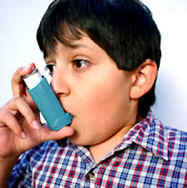
RESPIRATORY. Humid asthma. Chest oppressed with deep, labored breathing.

Slide 20
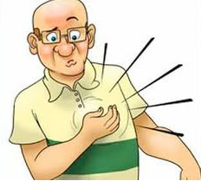
HEART. Palpitation awakes him. Piercing pain, with great oppression. Pulse very slow (Dig; Kalmia; Apocyn).

Slide 21
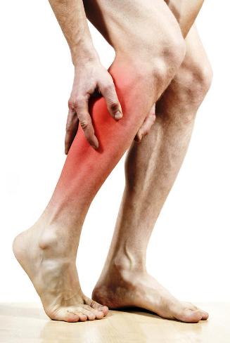
EXTREMITIES. Pain across shoulders and spine; must stoop; cannot walk erect. Thrilling through arms and hands, and from knees down. Entire paralysis of the lower extremities. Pain in soles and calves; sharp pains in knees and ankles; very exhausted after a short walk.

Slide 22
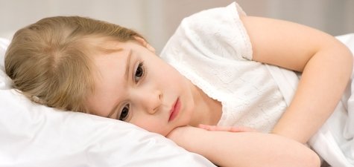
SLEEP. Very sleepy, but unable to do so. Obstinate and intractable forms of insomnia. Catalepsy. Dreams of dead bodies; prophetic. Nightmare.

Slide 23
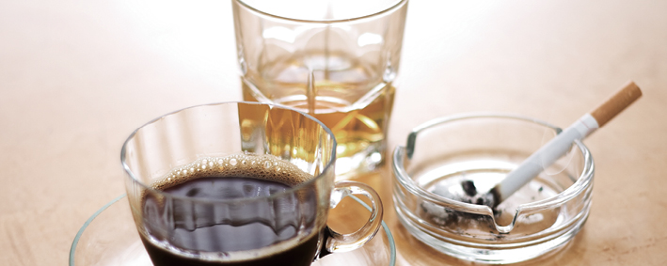
MODALITIES. Worse: morning; from coffee, liquor and tobacco; lying on right side. Better :from fresh air, cold water, rest.

Slide 24
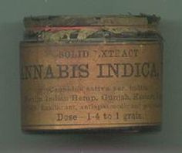
RELATIONSHIP. Bellad; Hyoscy; Stram; Laches; Agaric; Anhalon (time sense disordered; time periods enormously overestimated, thus, minutes seem hours, etc). DOSE. Tincture and low attenuations.

Slide 25
